Slide 1
Housing mobility in New Orleans Greater New orleans Fair housing action Center

Slide 2
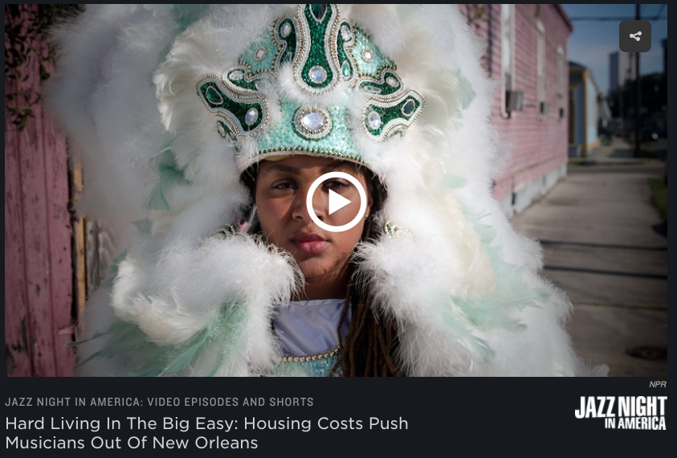
Hard living in the big Easy
Notes:
This is a good example of how data and information from the healthcare advocates can support housing equity. We need partners in many areas – criminal justice, education, employment, transportation, food justice, etc. to make connections between housing and opportunity.

Slide 3
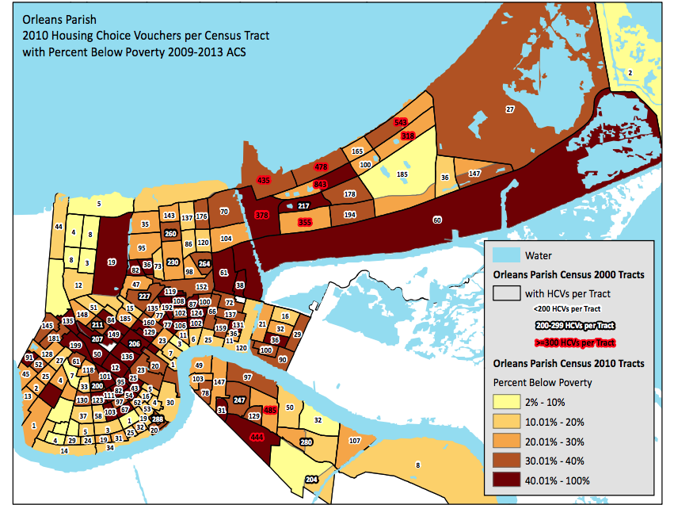
Families pushed to the Margins
Notes:
Federal Home Owners Loan Corporation – example of government sponsored redlining

Slide 4
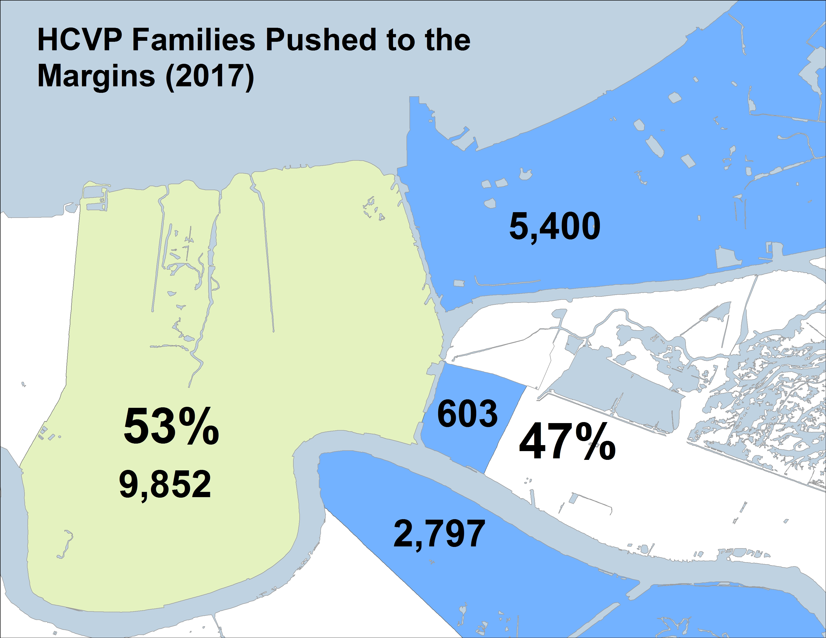
N.O. East, Lower 9, & Algiers
Notes:
Federal Home Owners Loan Corporation – example of government sponsored redlining

Slide 5
Exception Payment standards
Notes:
Federal Home Owners Loan Corporation – example of government sponsored redlining

Slide 6
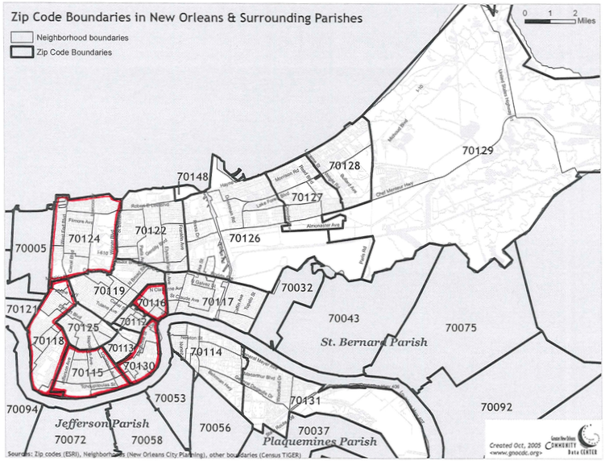
Exception Payment standards
Notes:
Federal Home Owners Loan Corporation – example of government sponsored redlining

Slide 7
Landlord recruitment
Notes:
Federal Home Owners Loan Corporation – example of government sponsored redlining

Slide 8
Feedback and Questions

Slide 9
Greater New orleans fair housing action center
404 S. Jefferson Davis Pkwy
New Orleans, LA 70119
(504) 596-2100
www.gnofairhousing.org
To download the National Fair Housing Alliance’s 2006 and 2007 Fair Housing Trends reports:
www.nationalfairhousing.org

